Slide 1
Verification and Validation

Slide 2
Objectives
To introduce software verification and validation and to discuss the distinction between them
To describe the program inspection process and its role in V & V
To explain static analysis as a verification technique
To describe the Cleanroom software development process

Slide 3
Topics covered
Verification and validation planning
Software inspections
Automated static analysis
Cleanroom software development

Slide 4
Verification vs validation
Verification:
"Are we building the product right”.
The software should conform to its specification.
Validation:
"Are we building the right product”.
The software should do what the user really requires.

Slide 5
The V & V process
Is a whole life-cycle process - V & V must be
applied at each stage in the software process.
Has two principal objectives
  The discovery of defects in a system;
  The assessment of whether or not the system is useful and useable in an operational situation.

Slide 6
V& V goals
Verification and validation should establish confidence that the software is fit for purpose.
This does NOT mean completely free of defects.
Rather, it must be good enough for its intended use and the type of use will determine the degree of confidence that is needed.

Slide 7
V & V confidence
Depends on system’s purpose, user expectations and marketing environment
  Software function
    The level of confidence depends on how critical the software is to an organisation.
  User expectations
    Users may have low expectations of certain kinds of software.
  Marketing environment
    Getting a product to market early may be more important than finding defects in the program.

Slide 8
Static and dynamic verification
Software inspections. Concerned with analysis of
the static system representation to discover problems (static verification)
  May be supplement by tool-based document and code analysis
Software testing. Concerned with exercising and
observing product behaviour (dynamic verification)
  The system is executed with test data and its operational behaviour is observed

Slide 9
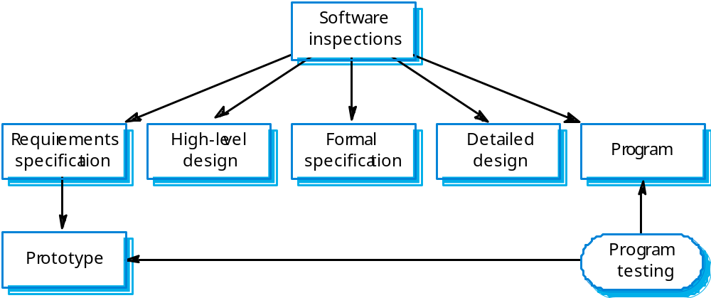
Static and dynamic V&V

Slide 10
Program testing
Can reveal the presence of errors NOT their
absence.
The only validation technique for non-functional requirements as the software has to be executed to see how it behaves.
Should be used in conjunction with static
verification to provide full V&V coverage.

Slide 11
Types of testing
Defect testing
  Tests designed to discover system defects.
  A successful defect test is one which reveals the presence of defects in a system.
  Covered in Chapter 23
Validation testing
  Intended to show that the software meets its requirements.
  A successful test is one that shows that a requirements has been properly implemented.

Slide 12
Testing and debugging
Defect testing and debugging are distinct
processes.
Verification and validation is concerned with establishing the existence of defects in a program.
Debugging is concerned with locating and
repairing these errors.
Debugging involves formulating a hypothesis
about program behaviour then testing these
hypotheses to find the system error.

Slide 13
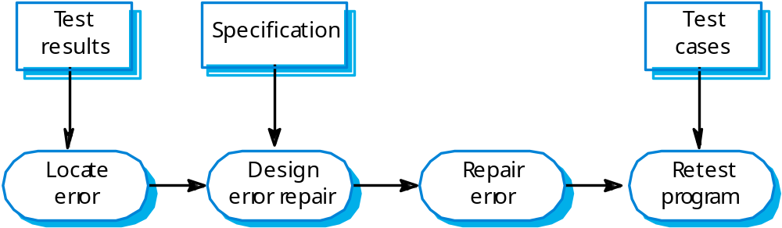
The debugging process

Slide 14
V & V planning
Careful planning is required to get the most out of testing and inspection processes.
Planning should start early in the development process.
The plan should identify the balance between static verification and testing.
Test planning is about defining standards for the testing process rather than describing product tests.

Slide 15
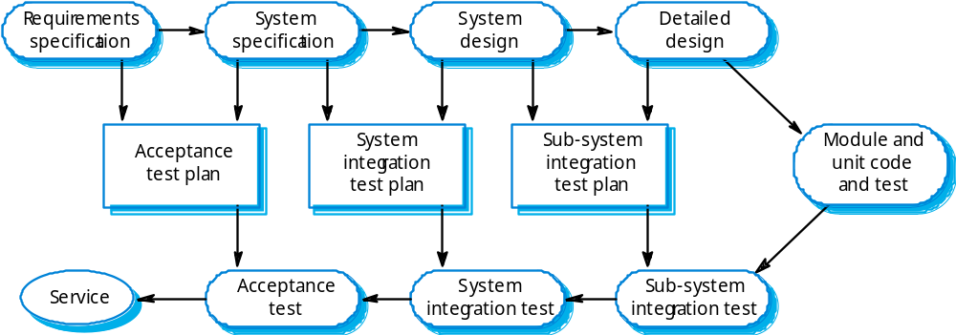
The V-model of development

Slide 16
The structure of a software test plan
The testing process.
Requirements traceability.
Tested items.
Testing schedule.
Test recording procedures.
Hardware and software requirements.
Constraints.

Slide 17
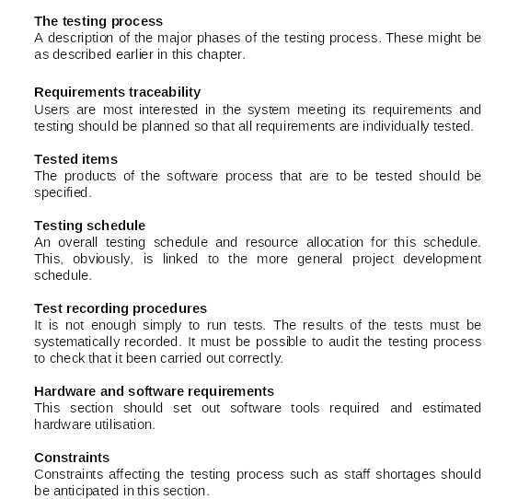
The software test plan

Slide 18
Software inspections
These involve people examining the source representation with the aim of discovering anomalies and defects.
Inspections not require execution of a system so may be used before implementation.
They may be applied to any representation of the system (requirements, design,configuration data, test data, etc.).
They have been shown to be an effective technique for discovering program errors.

Slide 19
Inspection success
Many different defects may be discovered in a single inspection. In testing, one defect ,may mask another so several executions are required.
The reuse domain and programming knowledge so reviewers are likely to have seen the types of error that commonly arise.

Slide 20
Inspections and testing
Inspections and testing are complementary and not opposing verification techniques.
Both should be used during the V & V process.
Inspections can check conformance with a specification but not conformance with the customer’s real requirements.
Inspections cannot check non-functional characteristics such as performance, usability, etc.

Slide 21
Program inspections
Formalised approach to document reviews
Intended explicitly for defect detection (not correction).
Defects may be logical errors, anomalies in the code that might indicate an erroneous condition (e.g. an uninitialised variable) or non-compliance with standards.

Slide 22
Inspection pre-conditions
A precise specification must be available.
Team members must be familiar with the
organisation standards.
Syntactically correct code or other system representations must be available.
An error checklist should be prepared.
Management must accept that inspection will
increase costs early in the software process.
Management should not use inspections for staff
appraisal ie finding out who makes mistakes.

Slide 23
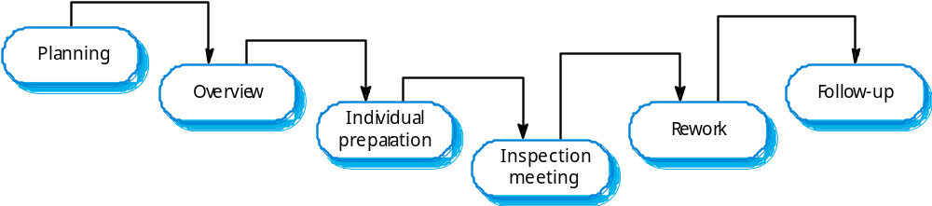
The inspection process

Slide 24
Inspection procedure
System overview presented to inspection team.
Code and associated documents are
distributed to inspection team in advance.
Inspection takes place and discovered errors
are noted.
Modifications are made to repair discovered
errors.
Re-inspection may or may not be required.

Slide 25
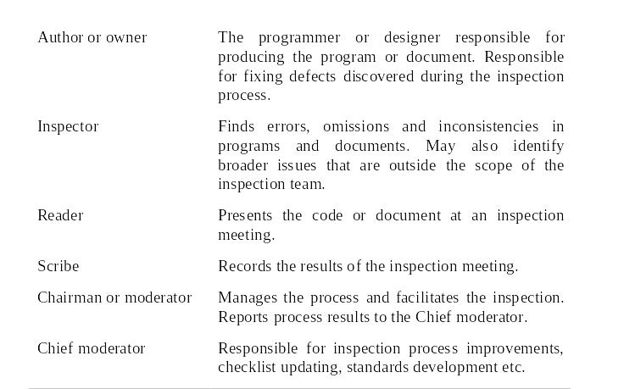
Inspection roles

Slide 26
Inspection checklists
Checklist of common errors should be used to
drive the inspection.
Error checklists are programming language
dependent and reflect the characteristic errors that are likely to arise in the language.
In general, the 'weaker' the type checking, the larger the checklist.
Examples: Initialisation, Constant naming, loop
termination, array bounds, etc.

Slide 27
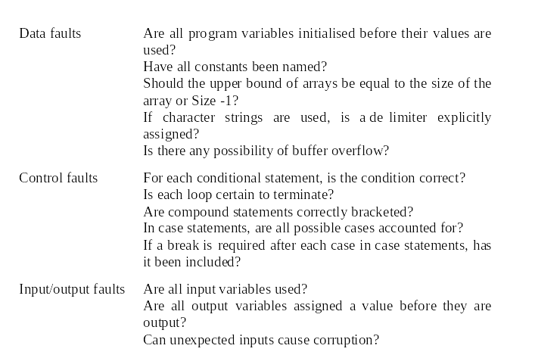
Inspection checks 1

Slide 28
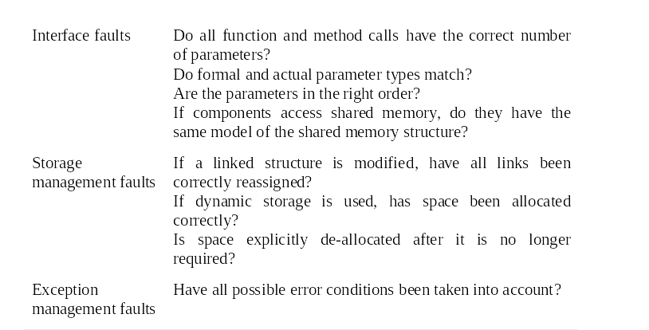
Inspection checks 2

Slide 29
Inspection rate
500 statements/hour during overview.
125 source statement/hour during individual
preparation.
90-125 statements/hour can be inspected.
Inspection is therefore an expensive process.
Inspecting 500 lines costs about 40 man/hours effort - about £2800 at UK rates.

Slide 30
Automated static analysis
Static analysers are software tools for source text processing.
They parse the program text and try to discover potentially erroneous conditions and bring these to the attention of the V & V team.
They are very effective as an aid to inspections - they are a supplement to but not a replacement for inspections.

Slide 31
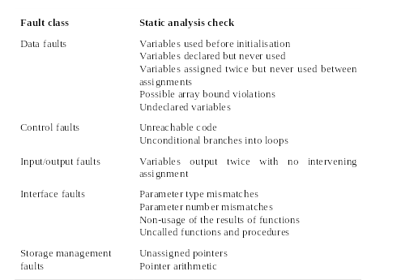
Static analysis checks

Slide 32
Stages of static analysis
Control flow analysis. Checks for loops with
multiple exit or entry points, finds unreachable
code, etc.
Data use analysis. Detects uninitialised
variables, variables written twice without an
intervening assignment, variables which are
declared but never used, etc.
Interface analysis. Checks the consistency of
routine and procedure declarations and their
use

Slide 33
Stages of static analysis
Information flow analysis. Identifies the
dependencies of output variables. Does not
detect anomalies itself but highlights
information for code inspection or review
Path analysis. Identifies paths through the program and sets out the statements executed in that path. Again, potentially useful in the review process
Both these stages generate vast amounts of information. They must be used with care.

Slide 34
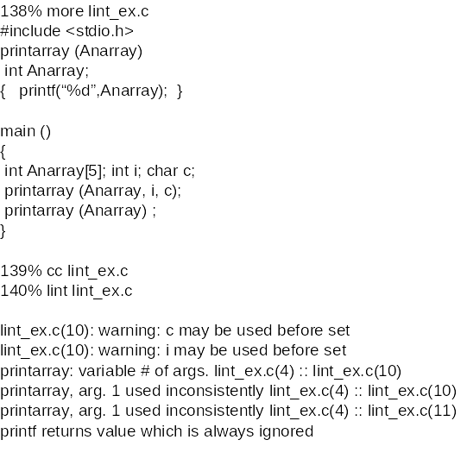
LINT static analysis

Slide 35
Use of static analysis
Particularly valuable when a language such as C is used which has weak typing and hence many errors are undetected by the compiler,
Less cost-effective for languages like Java that have strong type checking and can therefore detect many errors during compilation.

Slide 36
Verification and formal methods
Formal methods can be used when a mathematical specification of the system is produced.
They are the ultimate static verification technique.
They involve detailed mathematical analysis of the specification and may develop formal arguments that a program conforms to its mathematical specification.

Slide 37
Arguments for formal methods
Producing a mathematical specification requires a detailed analysis of the requirements and this is likely to uncover errors.
They can detect implementation errors before testing when the program is analysed alongside the specification.

Slide 38
Arguments against formal methods
Require specialised notations that cannot be understood by domain experts.
Very expensive to develop a specification and even more expensive to show that a program meets that specification.
It may be possible to reach the same level of confidence in a program more cheaply using other V & V techniques.

Slide 39
Cleanroom software development
The name is derived from the 'Cleanroom'
process in semiconductor fabrication. The
philosophy is defect avoidance rather than
defect removal.
This software development process is based on:
  Incremental development;
  Formal specification;
  Static verification using correctness arguments;
  Statistical testing to determine program reliability.

Slide 40
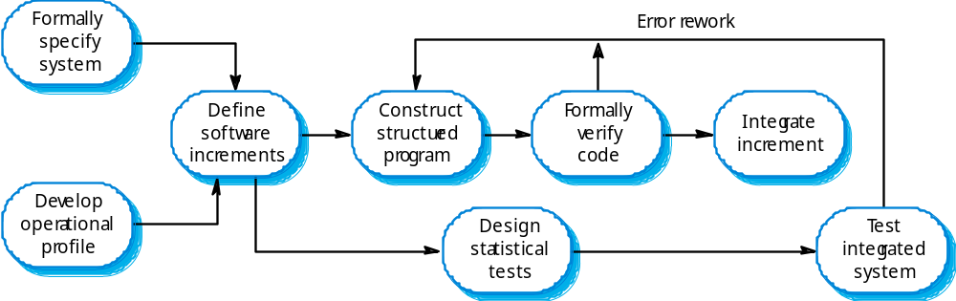
The Cleanroom process

Slide 41
Cleanroom process characteristics
Formal specification using a state transition model.
Incremental development where the customer prioritises increments.
Structured programming - limited control and abstraction constructs are used in the program.
Static verification using rigorous inspections.
Statistical testing of the system (covered in Ch. 24).

Slide 42
Formal specification and inspections
The state based model is a system specification and the inspection process checks the program against this mode.l
The programming approach is defined so that the correspondence between the model and the system is clear.
Mathematical arguments (not proofs) are used to increase confidence in the inspection process.

Slide 43
Cleanroom process teams
Specification team. Responsible for developing
and maintaining the system specification.
Development team. Responsible for
developing and verifying the software. The
software is NOT executed or even compiled
during this process.
Certification team. Responsible for developing
a set of statistical tests to exercise the software
after development. Reliability growth models
used to determine when reliability is acceptable.

Slide 44
Cleanroom process evaluation
The results of using the Cleanroom process have been very impressive with few discovered faults in delivered systems.
Independent assessment shows that the
process is no more expensive than other
approaches.
There were fewer errors than in a 'traditional' development process.
However, the process is not widely used. It is not clear how this approach can be transferred
to an environment with less skilled or less
motivated software engineers.

Slide 45
Key points
Verification and validation are not the same thing. Verification shows conformance with specification; validation shows that the program meets the customer’s needs.
Test plans should be drawn up to guide the testing process.
Static verification techniques involve examination and analysis of the program for error detection.

Slide 46
Key points
Program inspections are very effective in discovering errors.
Program code in inspections is systematically checked by a small team to locate software faults.
Static analysis tools can discover program anomalies which may be an indication of faults in the code.
The Cleanroom development process depends on incremental development, static verification and statistical testing.

